Slide 1

Managers Meeting March 4, 2020

Slide 2
Discretionary Grants
Discretionary Grants: A discretionary grant is awarded on the basis of a competitive process. The federal government uses discretionary grants to fund program activities when it is appropriate and essential for the government to identify the best possible projects to achieve particular program objectives. CPID and DEI are funded in this manner.

Slide 3
WIOA and CPID Comparison
WIOA Indicators of Performance
Employment Rate – 2nd Quarter After Exit
B. Employment Rate – 4th Quarter After Exit
C. Median Earnings – 2nd Quarter after Exit
CPID Indicators of Performance
A. Number of Career Pathways Accessed/Created
B. Employment Rate – 90 Days
C. Median Earnings – Per Quarter

Slide 4
WIOA and CPID Comparison Cont.
WIOA Indicators of Performance
D. Credential Attainment
E. Measurable Skill Gains
F. Effectiveness in Serving Employers
CPID Indicators of Performance
D. Credential Attainment
E. Measurable Skill Gains
Note: Working with Employers to establish demand is integral to VA’s CPID Strategy.
Notes:
The CPID Award is intended to pilot strategies that would help states align with WIOA measure focused on wages, credential attainment and measurable skill gains using a career pathways approach (WIOA took effect July 2015. RSA’s Career Pathway’s Grants started October 2015.
The last 6 months of the grant focuses on documenting outcomes, sustainability, evaluation, and dissemination to a national audience.

Slide 5
Formula Grant
Formula Grants: uses formulas determined by Congress and has no application process. VR programs are funded this way.

Slide 6

Your Numbers……
Notes:
Kate
Project results as of September 30, 2019 (FFY 2019):
•Number of Vocational Rehabilitation participants served by CPID grant: Proposed Goal: 470 To Date: 948
•Aggregate Number of Credentials earned by CPID project participants: Proposed Goal: 150 To Date: 222
•Number of CPID participants closed with competitive, integrated employment in a CPID career pathway: Proposed Goal: 150 To Date: 268

Slide 7
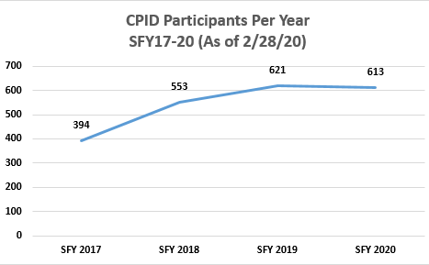

Slide 8
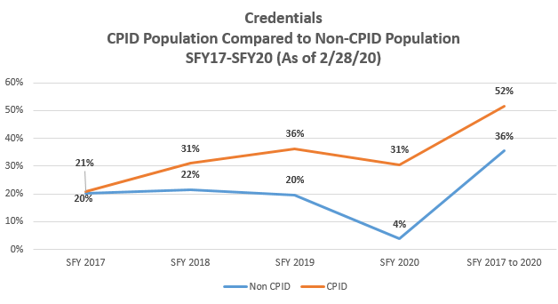

Slide 9
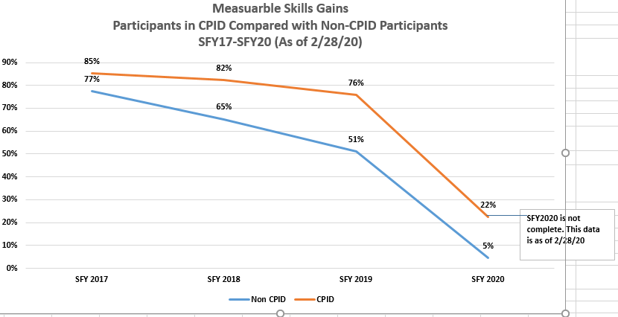

Slide 10

CPID Sustainability
Notes:
Georgia
Leave time for them to fill out form

Slide 11
Eco Map
Showing the relationships that Career Pathways initiatives have affected DARS activities, Partners, Systems, Individuals, Family and Counselors.
Notes:
Georgia?

Slide 12
Training
Webinars
Hidden Disabilities (1day -6 weeks)
BDM/OT/AT/VE & Placement Training
Employer/Instructor training
Motivational Interviewing
Counselor Professional Development
Train the Trainers
Notes:
Georgia – (?)
Autism training at dbvi
ESO – training Ytac training for working with blind and low vision
WWRC and blindness
Mental health training – ytac
Info

Slide 13
Joint Program Planning Work
Hampton
CASAS as a screening option
Hershey Boot Camp
DBVI/DARS
VSDB
Lunch and Learn NOVA
Notes:
Kate/ Tish/ Paula
Include Numbers here
Info…

Slide 14
Paid Internships
Page from DBVI
Ready for employment
IT experience
Temp Agencies as vendor
Notes:
Tish and Kate
Interactive

Slide 15
Paid Internship
Candidate
Accessible Training
Counselor
Employer
Budget

Slide 16
OOS Counselor
People are waiting
Referral to other resources
Attend Job Club?
Sheet for next steps
Notes:
Laurie – add in sheet for next steps
Info –
Interactive -

Slide 17
Outreach Events
Tours
Credential Fairs
Hando on Academies
Informational Sessions
Notes:
Tish/kate
interactive

Slide 18
Pre-ETS Activities
Academies
Career Counseling
Presentations at High Schools
Worlds of Work
Tours
Notes:
Kate – Tish
interactive

Slide 19
Labor Market Information
Career Counseling
Quarterly updates
Plan overviews
Demand/Supply Side Meetings
Evaluations
Notes:
Kate/Tish
Interactive
Use of existing partners

Slide 20
Training Options
Leveraged Training
Articulation Agreements
Intellectual Point
Cohorts
Articulation Agreements
Notes:
Partner Training
WWRC WIOA Certified

Slide 21
Adult Education
Bridge
Skills Deficient
Hidden Disabilities Training
Notes:
Kate
VALRC

Slide 22
Counselor HACKS
Career Exploration and Pre-Planning Resources
Planning Resources
Outcomes
Resources

Slide 23
Credential Outlines…
31-0000 | Healthcare Support Occupations
311014 | Nursing Assistants
 | Certified Nurse Aide (CNA)
 | Advanced Emergency Medical Technician (AEMT)
 | Pediatric Advanced Life Support
 | Advanced Cardiac Life Support (ACLS
319091 | Dental Assistants
319092 | Medical Assistants
 | Certified Medical Administrative Assistant (CMAA)
 | Medication Aide
 | Clinical Medical Assistant (CCMA)
319097 | Phlebotomists
Notes:
Georgia (?)

Slide 24
Training and Credentials Rackcards
Regionally created
Includes Fast Forward Credentials
Adult Education options
Notes:
Georgia (?)

